Slide 1
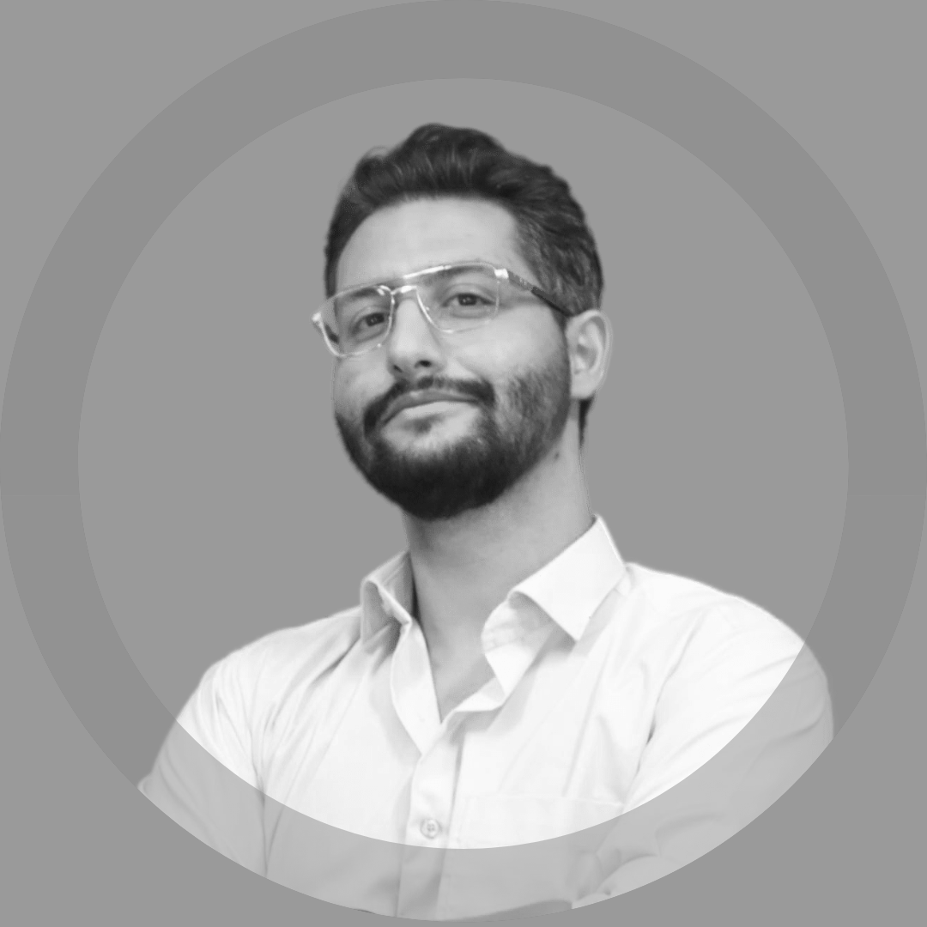







Mohammad Sina
Allahkaram
https://www.linkedin.com/in/msinamsina
https://github.com/msinamsina
msinamsina@gmail.com
Full stack Developer
ML Engineer
Roboticist
https://msina.me
09981075065
HIGHLIGHTS
LANGUAGES
Experienced Python programmer with 7+ years in developing AI-based web/desktop applications and frameworks.
Software designer committed to KISS, SOLID, Clean Code principles, TDD, and design patterns for scalable solutions.
Team lead and key member of the KN2C Robotic Team, enhancing problem-solving skills, overcoming challenges, and meeting deadlines.
Systemic thinker who fosters effective collaboration and meaningful interactions within teams.
Expert in production environments and CI/CD, driving development speed through automated pipelines.
Persian
Native
English
Fluent
SOFT SKILLS
Agile
Teamwork
Problem Solving
Leadership Skill
EDUCATIONAL BACKGROUND
HARD SKILLS
Master's degree 2019-2023
K. N. Toosi University of Technology
Mechatronics Engineering
Thesis Title: Development of an image-based deep neural network for hatronics, Engineering human parsing for human behavior classification
Python
+7 Years Exp.
Computer Vision
+8 Years Exp.
Deep Learning
+5 Years Exp.
Git
+7 Years Exp.
Docker & Docker swarm
+2 Years Exp.
Embedded Sys.
+5 Years Exp.
Bachelor's degree 2014-2019
K. N. Toosi University of Technology
Electrical and Electronics Engineering
Thesis Title: Hardware implementation of motion estimation function in H.264 video encoder
CICD
+2 Years Exp.
Linux
LPIC1
Clean Code
TDD, PEP8
Software Architecture Design
Full Design of
+20 Applications

Slide 2


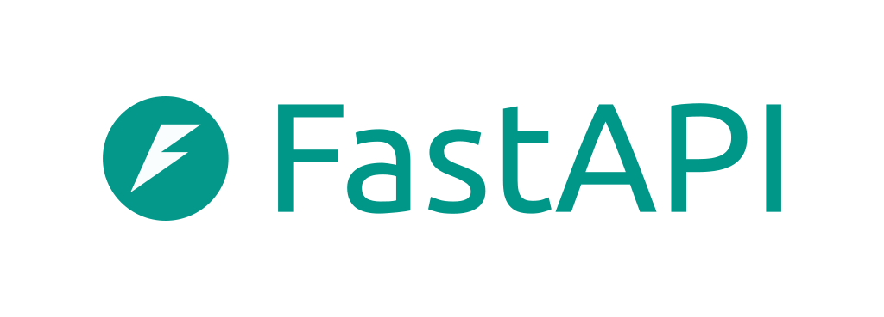









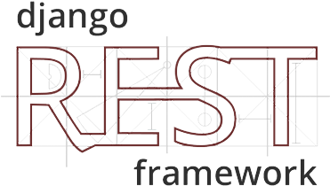










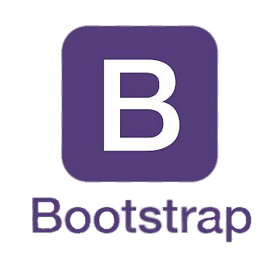


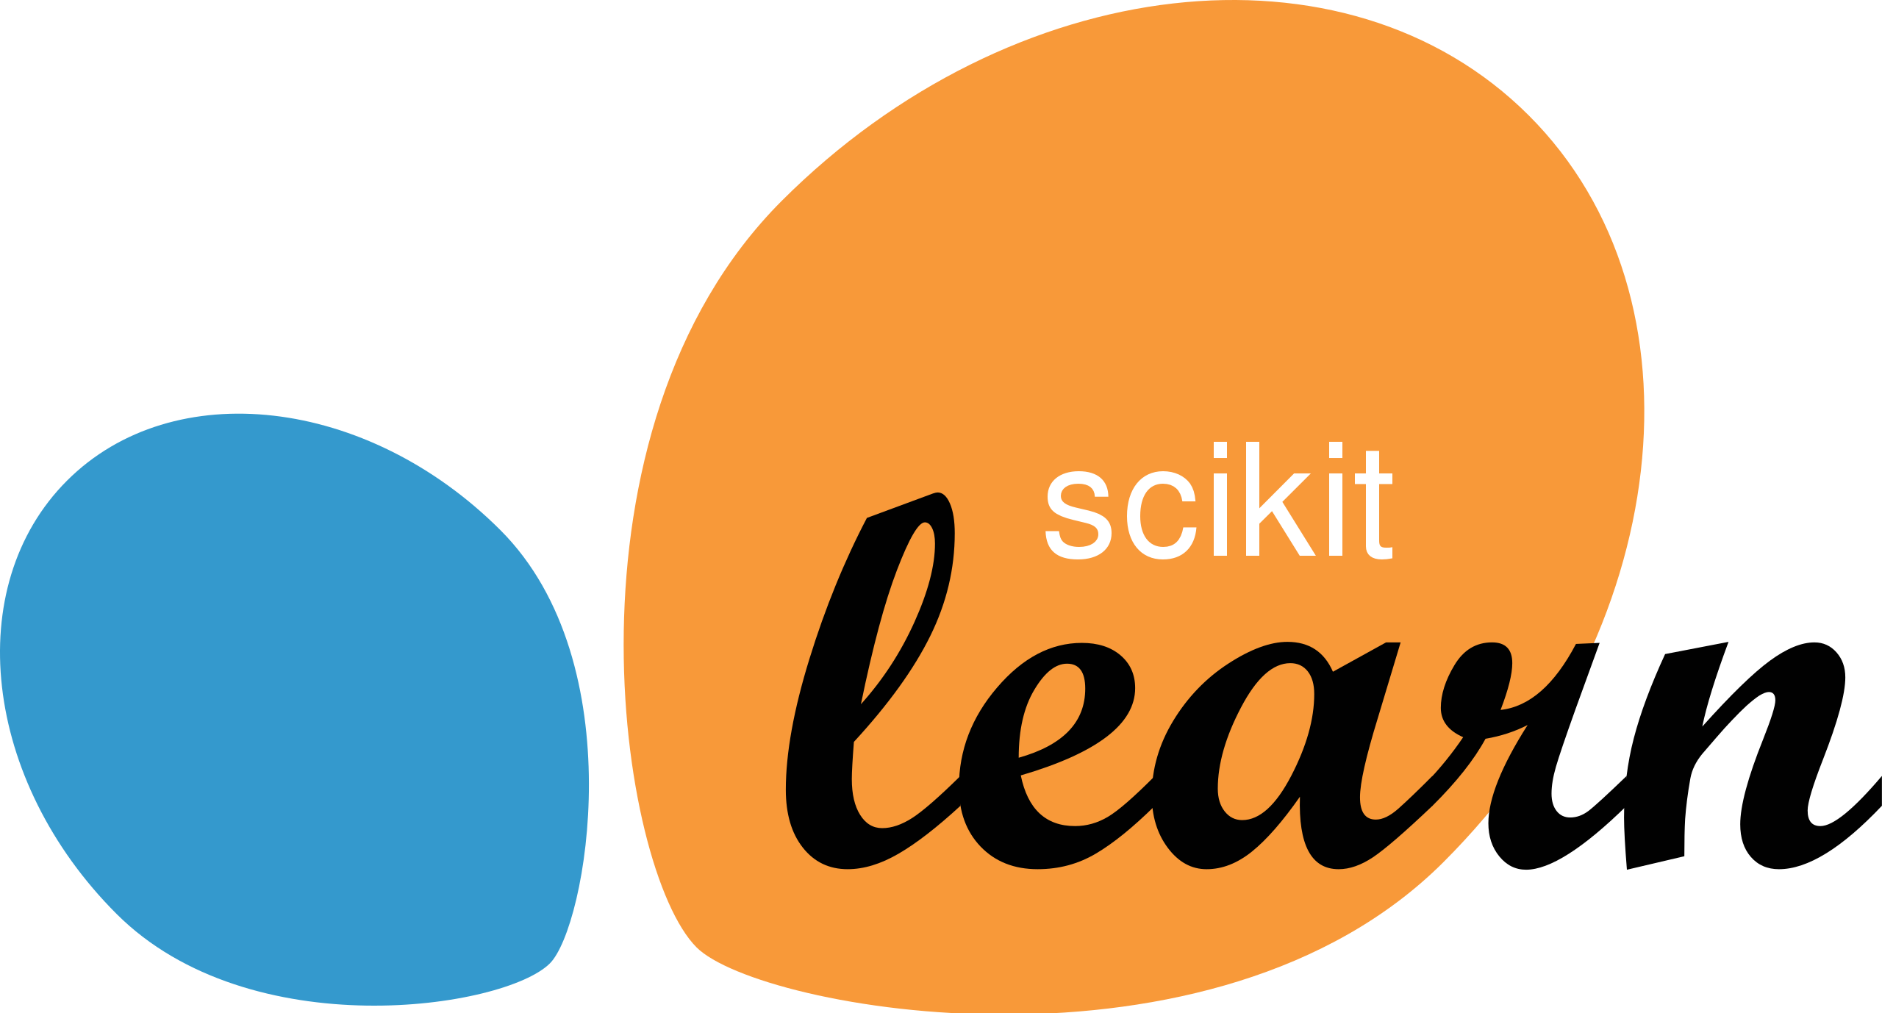






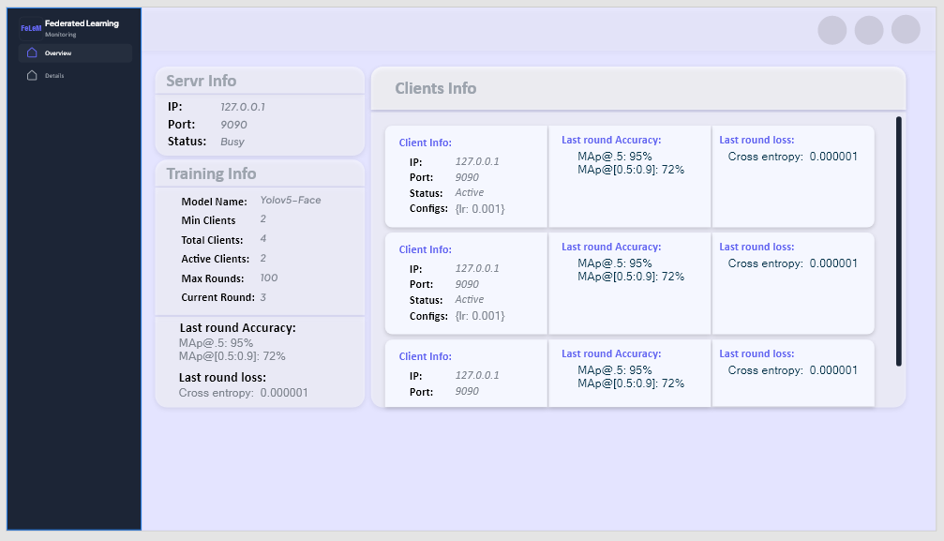

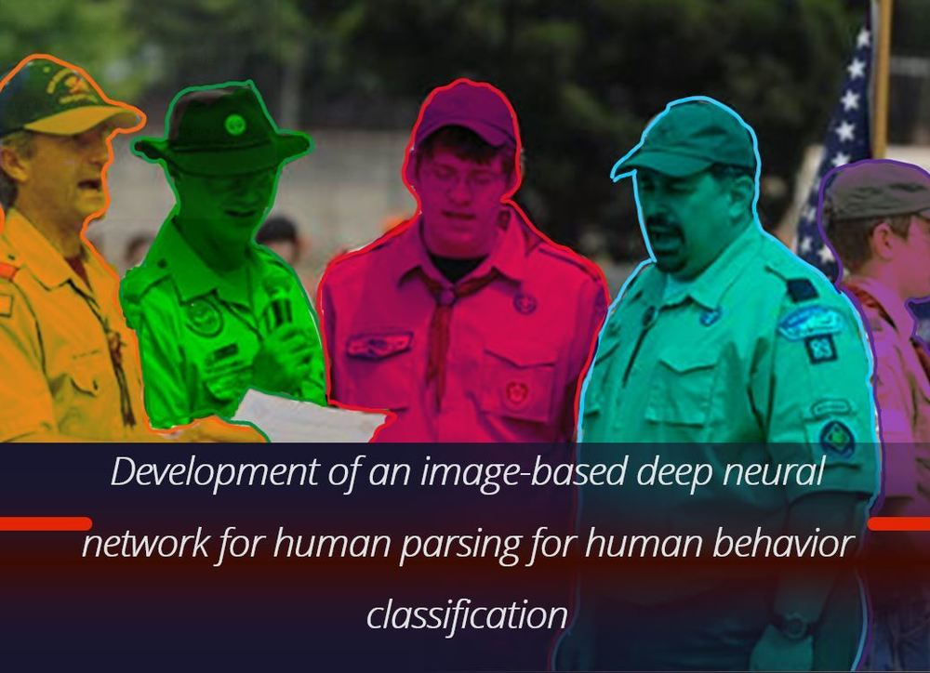



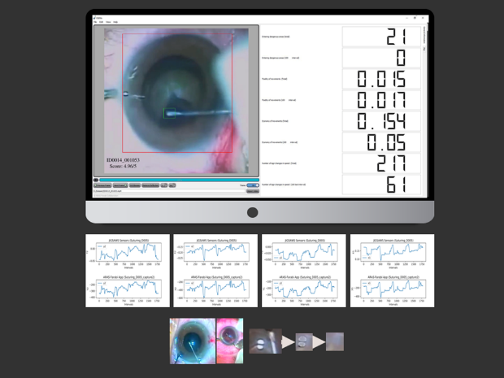

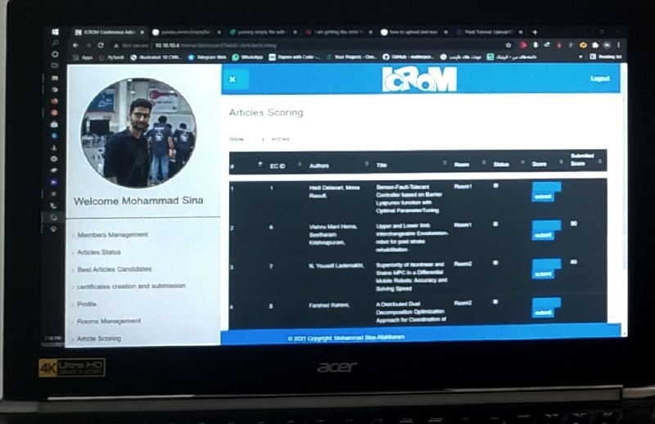
TECHNOLOGIES
Over the past few years, I have consistently utilized the following frameworks, libraries, databases, and services across my projects to optimize performance, streamline development processes, and reduce both time and costs.
NOTABLE PROJECTS
FELEM | A Federated Learning Framework
In this project, a highly configurable federated learning framework is created by focusing on defense against the reconstruction attacks based on gradient.
Parsing-Detectron | A Deep Learning Framework
For Human Parsing Task
https://github.com/msinamsina/Parsing-Detectron
In this project, the Detectron2 framework has been modified. Parsing-Detectron can be used for either detection and segmentation tasks or human parsing tasks.
PyAutoMail | A Python Package For Large Scale Email Automation
https://github.com/msinamsina/pyautomail
https://pyautomail.readthedocs.io/en/latest/
This Python package can be used for easy email automation, and additionally, it has a Command-Line interface for creating email queues and sending personalized emails to your contact lists.
ESEL| Eye Surgery Evaluation and Labelling
https://drive.google.com/file/d/1oLa4BN6Livk69FaOX7VSaMq09awFhbCD/view
ESEL is a desktop application that can be used for evaluating Capsulorhexis Eye Surgery based on surgical videos. Furthermore, this application is used for semi-automated labeling in pupil and surgical instrument detection and tracing tasks.
Persian Chair | A Web Application For
Evaluating the Articles
The Persian Chair (PCH) is a Django web application developed in response to a request from the ICRoM Conference.
Django

Slide 3
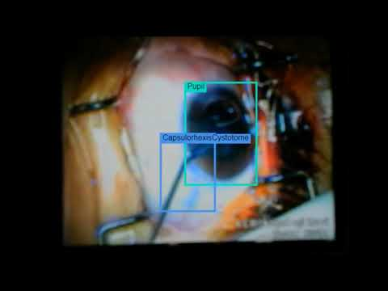
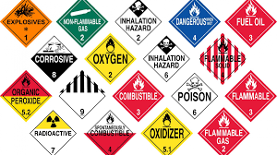
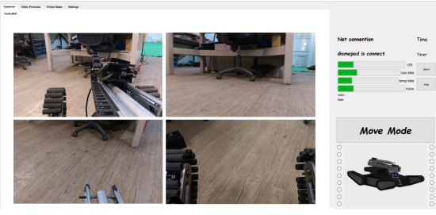








ARAS Deep Learning Framework| A Deep
Learning Framework For object detection
https://github.com/msinamsina/ARAS-DeepLearning-FW
In this project, a deep learning framework has been created from scratch for the object detection task, specifically designed for detecting pupils and Capsulorhexis surgery instruments.
Hazmat Detection | Hazardous Materials (HAZMAT)
Sign Detection
In this project, a hazardous materials (HAZMAT) sign dataset was prepared and utilized to train YOLO for creating a hazmat detector.
Rescue Robot Remote Control APP | A Desktop App
For Tele-Operating of UGV Robot
This is a desktop application that provides a graphical user interface for controlling and interacting with the KN2C Rescue Robot. Additionally, this application includes several sub-applications capable of automatically handling tasks such as hazmat detection, path planning, and inverse kinematics for the 7-DOF robotic arm.
WORK EXPERINCES
Senior Backend Developer for AI Services | PAYA Company (2023-Now)
Software Designer | Machine Learning Expert | Backend Developer | AI Engineer
Freelancer | Self Employed (2023-Now)
Software Designer | Machine Learning Expert | Full-Stack Developer
Computer Vision Researcher | ARAS Laboratory (2018-2023)
Computer Vision Researcher | Machine Learning Researcher | Software Developer
Full Stack Developer | IT Team of ICRoM Conference (2018-2023)
Software Developer | Full-Stack Developer
CTO | Rahbin Sanat Nasir Company (2022-2023)
Chief Technical Officer | Software-Hardware Designer | Computer Vision Expert
Founder & Developer | BYT Team (2020-2022)
Founder | Develop Algo Trading bots | Web Crawling | AI Engineer
hardware developer | Ride-On Company (2017-2018)
Digital Electronics Engineer | Embedded Systems Developer
Team Leader, Software-Hardware developer | KN2C Robotic Team (2014-2018)
Human Resources Management | Digital Electronics Engineer | Embedded Systems Developer
Software Developer and Desktop Application Designer | Junior computer vision engineer

Slide 4


ACHIVMENTS AND HONOR
Top Rank (Second Place) | In the undergraduate Level (M. Sc) 2023
IEEE Reviewer | Review in IEEE Transactions on Medical Robotics and Bionics 2023
Third place | RoboCup Asia-pacific Rescue robot league 2018
Third place | Iran Open Rescue robot league 2017, 2018
Second place | ICRoM Creative Exhibition 2016
Fifth place | RoboCup Rescue robot league 2017
PUBLICATIONS
https://scholar.google.com/citations?user=ejhATTMAAAAJ&hl=en
Image Processing and Machine Vision in Surgery and Its Training https://joc.kntu.ac.ir/article-1-999-en.html Automating surgical procedures using image processing and machine vision, focusing on instrument tracking and skill assessment. Reviewed datasets and advancements in image-guided systems for robotic assistance.
ARAS-Farabi Experimental Framework for Skill Assessment in Capsulorhexis Surgery https://ieeexplore.ieee.org/document/9663494/ This article proposes a new dataset for Capsulorhexis Surgery and introduces a new deep learning framework.
Surgical Instrument Tracking for Capsulorhexis Eye Surgery Based on Siamese Networks https://ieeexplore.ieee.org/document/10025355/ Surgical instrument tracking is a challenging task that can be used for evaluating surgeon performance. This paper presents a new method for tracking surgical instruments during Capsulorhexis Surgery.
Closed-form Inverse kinematics Equations of a Robotic Finger Mechanism https://ieeexplore.ieee.org/document/9663448 Obtaining closed-form inverse kinematics equations for serial arms with arbitrary structures is a challenging task. However, this article proposes closed-form inverse kinematics equations that can be used for a large group of serial robots with fewer than 5 links.
RoboCup rescue 2017 team description paper KN2C https://robocup-rescue.github.io/team_description_papers/2017/Champ2017_Iran_KN2C.pdf This article introduces a UGV Robot designed with a focus on minimizing reliance on prebuilt parts (both electrical and mechanical) and reducing the total cost, not only for robotic competitions but also with the goal of later global use in rescue missions.

Slide 5

TEACHING EXPERINCES
Computer Vision & Deep Learning Course | ARAS Academy (2022)
Robotics for kids | ARAS Academy (2019)
TA of Robotics Course |K. N. Toosi university of Technology (2017,2016)
TA of Micro-Processors Course | K. N. Toosi university of Technology (2015)
Electronic in robotic | KN2C Laboratory (2016)
Robotics for kids | Seyidkhandan neighborhood hall (2017)

